Slide 1
VMT in CEQA
Changes in Transportation Analysis
Town of Los Gatos
Joint Study Session
October 8, 2019
Ronald T. Milam, AICP, PTP

Slide 2
Outline
1. Background on SB 743
2. What is VMT?
3. Decisions
  Methods
  Screening
  Thresholds
  Mitigation
  4. Discussion

Slide 3

Background.
SB 743
AB 417
AB 2245
www.fehrandpeers
SB 226
AB 1358
innovation
SB 375
+10 California Climate
change Executive Orders
since 2004
SB 97
AB 32
3

Slide 4
Background.
SB 743 Legislative Intent
(1) Ensure that the environmental impacts of traffic, such as noise, air pollution, and safety concerns, continue to be properly addressed and mitigated through the California Environmental Quality Act.
(2) More appropriately balance the needs of congestion management with statewide goals related to infill development, promotion of public health through active transportation, and reduction of greenhouse gas emissions.
www.fehrandpeers
innovation
4

Slide 5
Background.
What Does
SB 743 Do?
Eliminates LOS/Delay as a significance threshold
Adds VMT as a CEQA significance threshold
Provides methods and thresholds guidance
Changes where significant impacts occur
Changes mitigation focus
www.fehrandpeers
innovation
5
Notes:
Delay/LOS no longer the sole basis for impact significance
VMT new metric
- OPR to provide guidance on methodology and significance criteria
CASE LAW
NEPA
Conservation Law Found. v. FHA (2007) 630 F. Supp. 2d 183
CEQA
Cal. Clean Energy Comm. v. Woodland (2014) 225 Cal.App.4th 173
Cleveland Nat’l Forest Fntd. v. SANDAG (2014) _ Cal.App.4th _

Slide 6
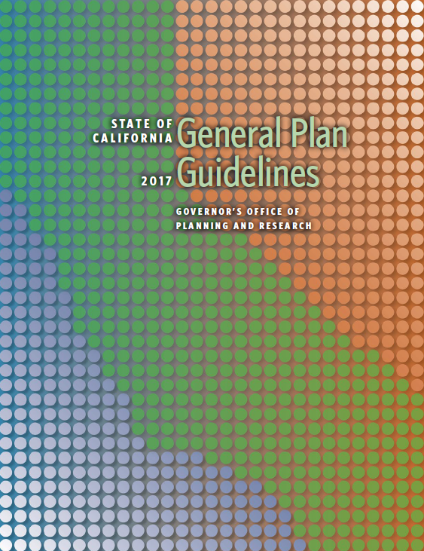
Background.
What SB 743 Does Not Do…
No change to general plans, traffic impact fee programs, State Constitution, subdivision map act, etc.
www.fehrandpeers
innovation
6

Slide 7
Background.
Sep. 2013
Governor Signed Bill
Dec. 2018 CEQA Guidelines updated
Jul. 2020
VMT is Mandatory for LU projects
Apr. 2019
LOS Prohibited in CEQA for LU projects
Status

Slide 8
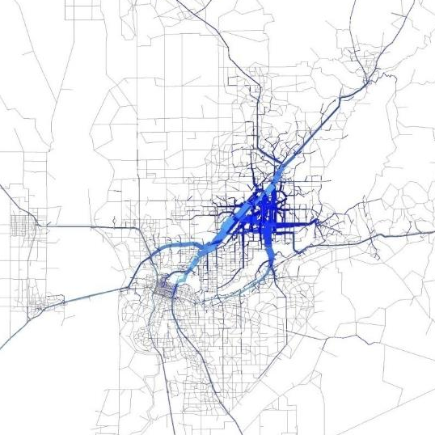
What is VMT?
VMT = Vehicle Trips x Trip Length

Slide 9
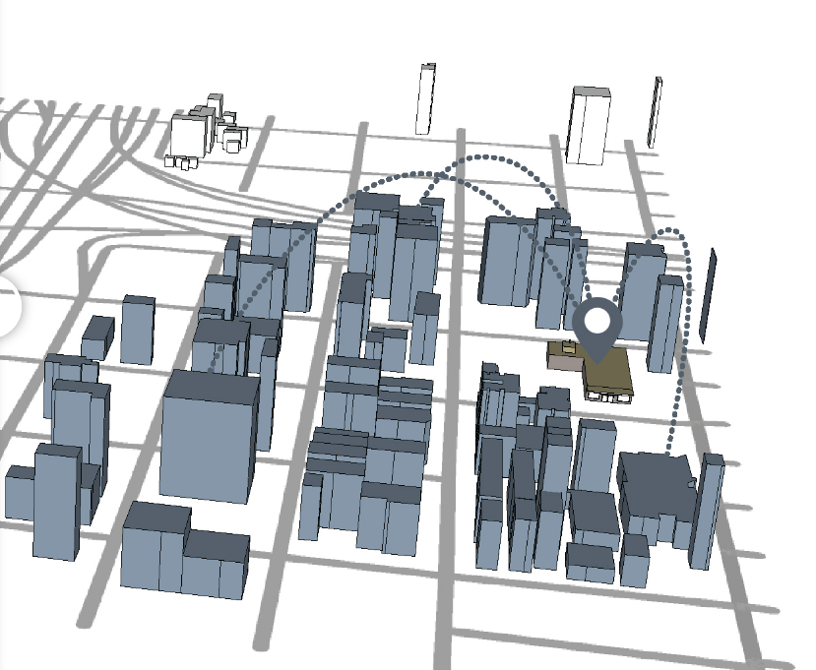
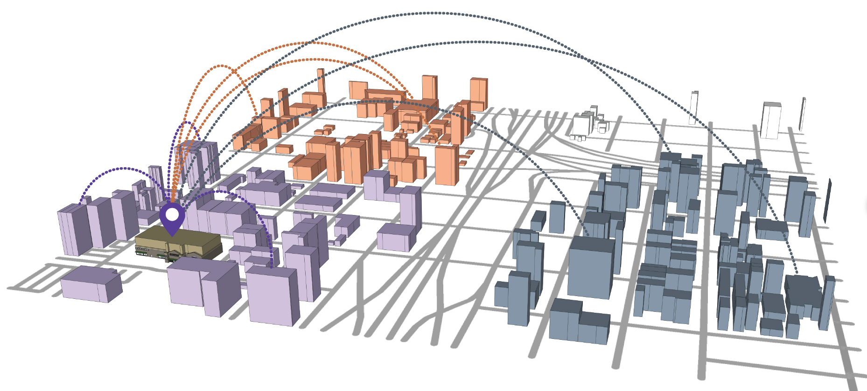
What is VMT?
Project Generated VMT vs Project Effect on VMT

Slide 10
VMT Consistency?
Current use of VMT in CEQA Analysis
  Air Quality
  Greenhouse Gases
  Energy
New use of VMT in CEQA Analysis
  Transportation per SB 743

Slide 11
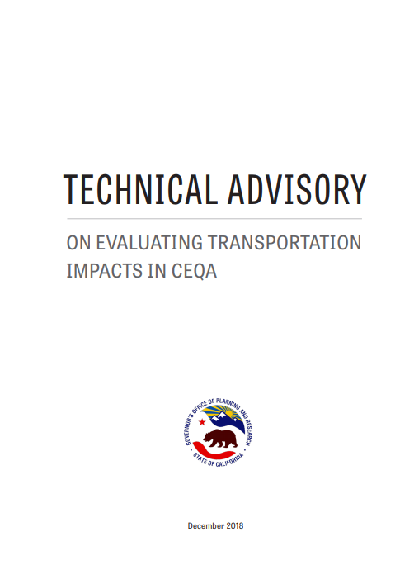
Decisions
VMT Methodology
  VMT Metric
  Model/Tool
Thresholds
  Project
  Cumulative
Screening
Feasible Mitigation
  Limitations of TDM

Slide 12
Decisions
CEQA Guidelines – Expectations for Environmental Impact Analysis
§ 15003 (f) = fullest possible protection of the environment…
§ 15003 (i) = adequacy, completeness, and good-faith effort at full disclosure…
§ 15125 (c) = the eir must demonstrate that the significant environmental impacts of the proposed project were adequately investigated…
§ 15144 = an agency must use its best efforts to find out and disclose…
§ 15151 = sufficient analysis to allow a decision which intelligently takes account of environmental consequences…

Slide 13
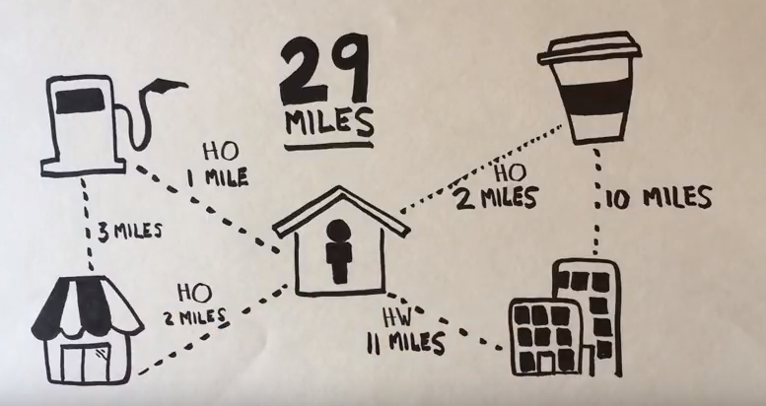
Decisions
VMT Metric Forms
Household VMT
Home-Based VMT
Home-Based Work VMT
16
11

Slide 14
Decisions
VMT Metric
Daily Total VMT per Service Population - sum of all weekday VMT generated by trips with at least one trip end in the study area divided by the residents and workers within the study area

Slide 15
Decisions
Screening
Lead agency may screen out VMT impacts using:
  project size
  location at a low-VMT generating area
  transit availability
  provision of affordable housing

Slide 16
Decisions
Establishing VMT Threshold(s)
Lead agency discretion
The Technical Advisory recommends the 15 percent VMT reduction thresholds and two alternative thresholds from the California Air Resources Board (ARB).
What is acceptable vs. unacceptable VMT when viewed solely through a transportation lens?
Multiple options depending on…
  how VMT reduction is valued by lead agency
  how VMT reduction is addressed in air quality, energy, and GHG impact analysis
  courts

Slide 17
Decisions
Feasible Mitigation
Two types of VMT reduction strategies
  Built-environment changes (e.g., 7Ds)
  Transportation demand management (TDM) strategies
Built Environment
  Is changing the project land use or transportation network feasible?
Travel Demand Management
  Effectiveness depends on project site context and tenants
  Requires monitoring

Slide 18
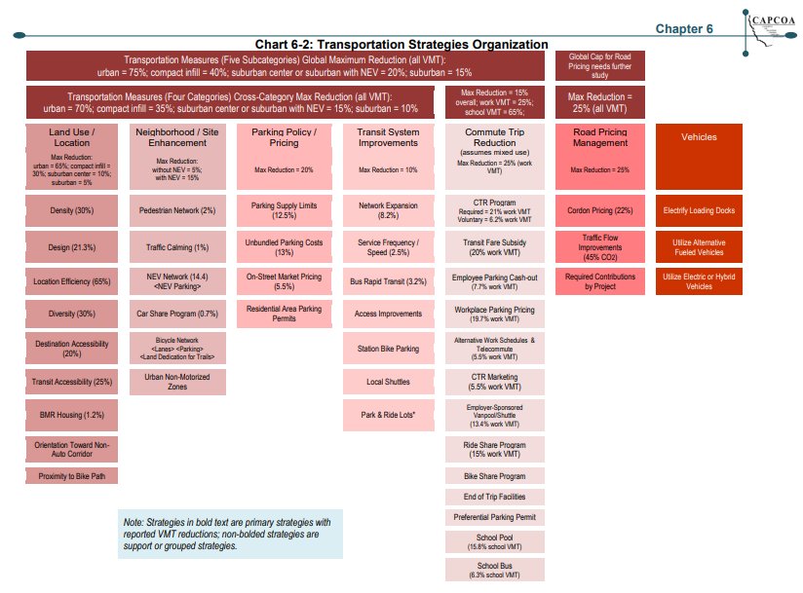
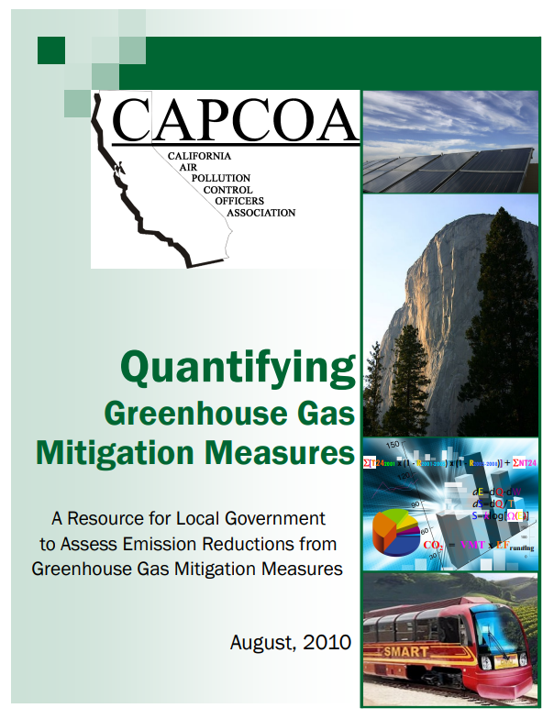
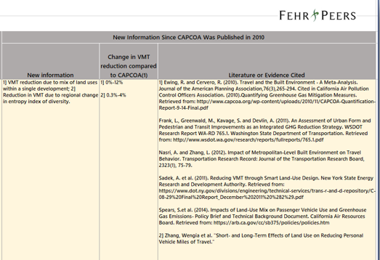
Decisions
Feasible Mitigation
New ARB research on VMT reduction strategies
  Tenant Dependent
Project vs Program approach
Fee Program

Slide 19
Next Steps
December 2019 | VMT Analysis Methodology
January 2020 | Impact Thresholds
February 2020 | Impact Screening
March 2020 | Mitigation Options
May 2020 | Adoption of Final VMT Policies

